Slide 1
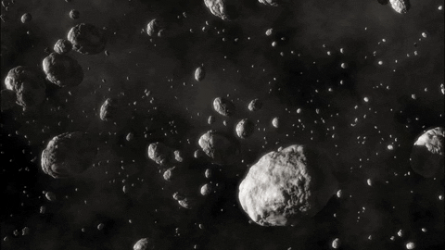
Meteor Landings Dataset with Data Scientist Scott ’Smash’ Sturtz https://github.com/SmashAF

Slide 2
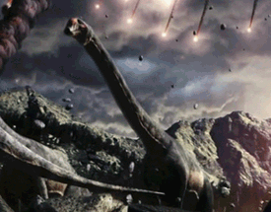


Slide 3
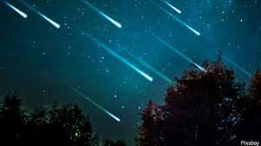
 | name | id | nametype | recclass | mass | fall | year | reclat | reclong | GeoLocation
0 | Aachen | 1 | Valid | L5 | 21.0 | Fell | 1880.0 | 50.77500 | 6.08333 | (50.775000, 6.083330)
1 | Aarhus | 2 | Valid | H6 | 720.0 | Fell | 1951.0 | 56.18333 | 10.23333 | (56.183330, 10.233330)
2 | Abee | 6 | Valid | EH4 | 107000.0 | Fell | 1952.0 | 54.21667 | -113.00000 | (54.216670, -113.000000)
3 | Acapulco | 10 | Valid | Acapulcoite | 1914.0 | Fell | 1976.0 | 16.88333 | -99.90000 | (16.883330, -99.900000)
4 | Achiras | 370 | Valid | L6 | 780.0 | Fell | 1902.0 | -33.16667 | -64.95000 | (-33.166670, -64.950000)
5 | Adhi Kot | 379 | Valid | EH4 | 4239.0 | Fell | 1919.0 | 32.10000 | 71.80000 | (32.100000, 71.800000)
6 | Adzhi-Bogdo (stone) | 390 | Valid | LL3-6 | 910.0 | Fell | 1949.0 | 44.83333 | 95.16667 | (44.833330, 95.166670)
7 | Agen | 392 | Valid | H5 | 30000.0 | Fell | 1814.0 | 44.21667 | 0.61667 | (44.216670, 0.616670)
8 | Aguada | 398 | Valid | L6 | 1620.0 | Fell | 1930.0 | -31.60000 | -65.23333 | (-31.600000, -65.233330)
9 | Aguila Blanca | 417 | Valid | L | 1440.0 | Fell | 1920.0 | -30.86667 | -64.55000 | (-30.866670, -64.550000)
10 | Aioun el Atrouss | 423 | Valid | Diogenite-pm | 1000.0 | Fell | 1974.0 | 16.39806 | -9.57028 | (16.398060, -9.570280)
11 | Aïr | 424 | Valid | L6 | 24000.0 | Fell | 1925.0 | 19.08333 | 8.38333 | (19.083330, 8.383330)
12 | Aire-sur-la-Lys | 425 | Valid | Unknown | NaN | Fell | 1769.0 | 50.66667 | 2.33333 | (50.666670, 2.333330)
13 | Akaba | 426 | Valid | L6 | 779.0 | Fell | 1949.0 | 29.51667 | 35.05000 | (29.516670, 35.050000)
14 | Akbarpur | 427 | Valid | H4 | 1800.0 | Fell | 1838.0 | 29.71667 | 77.95000 | (29.716670, 77.950000)
15 | Akwanga | 432 | Valid | H | 3000.0 | Fell | 1959.0 | 8.91667 | 8.43333 | (8.916670, 8.433330)
16 | Akyumak | 433 | Valid | Iron, IVA | 50000.0 | Fell | 1981.0 | 39.91667 | 42.81667 | (39.916670, 42.816670)
17 | Al Rais | 446 | Valid | CR2-an | 160.0 | Fell | 1957.0 | 24.41667 | 39.51667 | (24.416670, 39.516670)
18 | Al Zarnkh | 447 | Valid | LL5 | 700.0 | Fell | 2001.0 | 13.66033 | 28.96000 | (13.660330, 28.960000)
19 | Alais | 448 | Valid | CI1 | 6000.0 | Fell | 1806.0 | 44.11667 | 4.08333 | (44.116670, 4.083330)

Slide 4
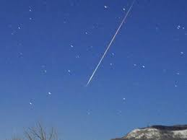
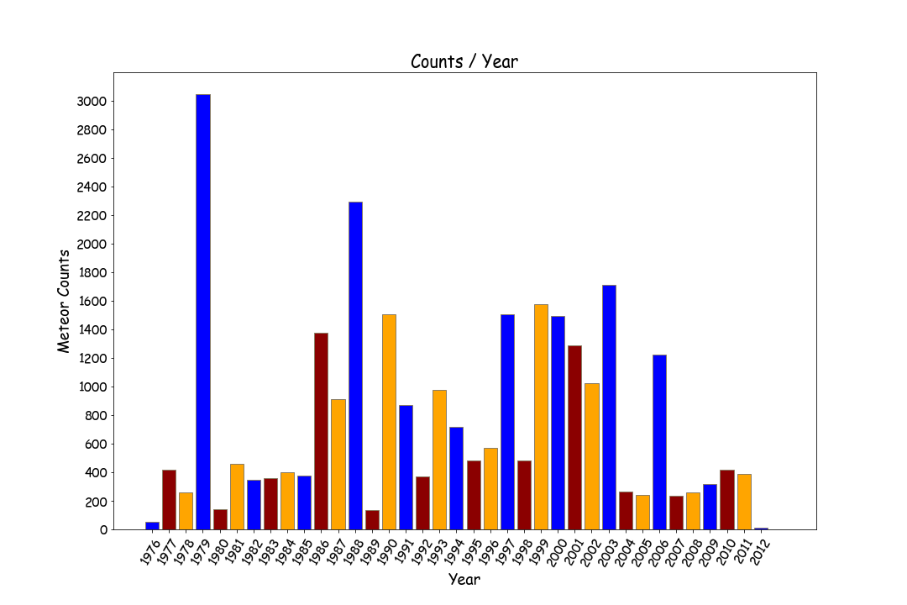

←How did we survive the 70’s?

Slide 5
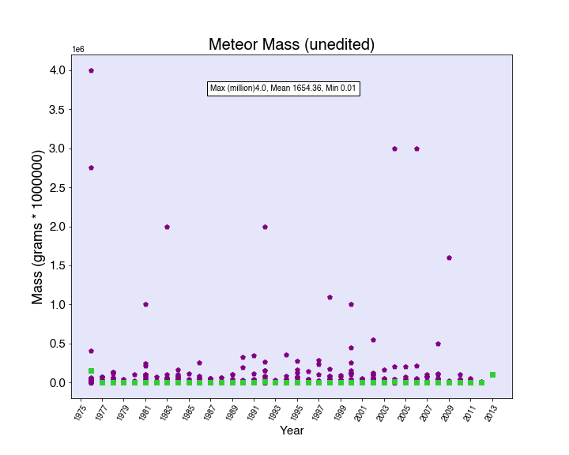
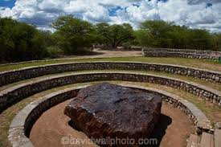

Slide 6

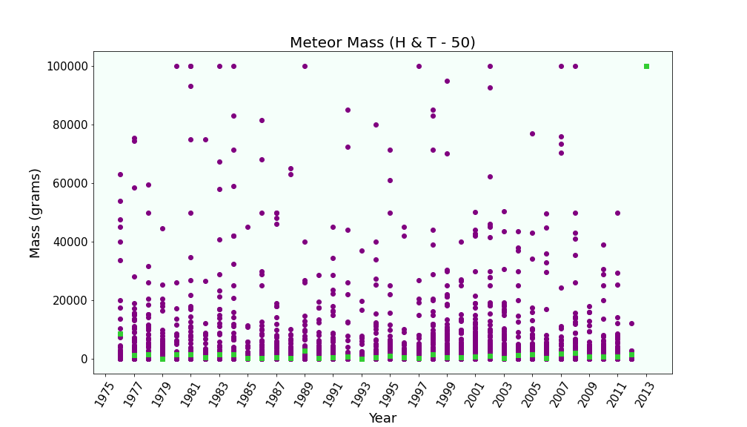
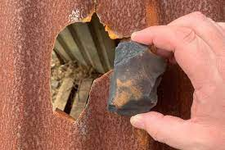
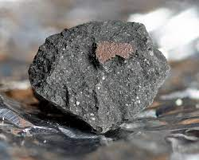
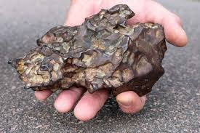

Slide 7
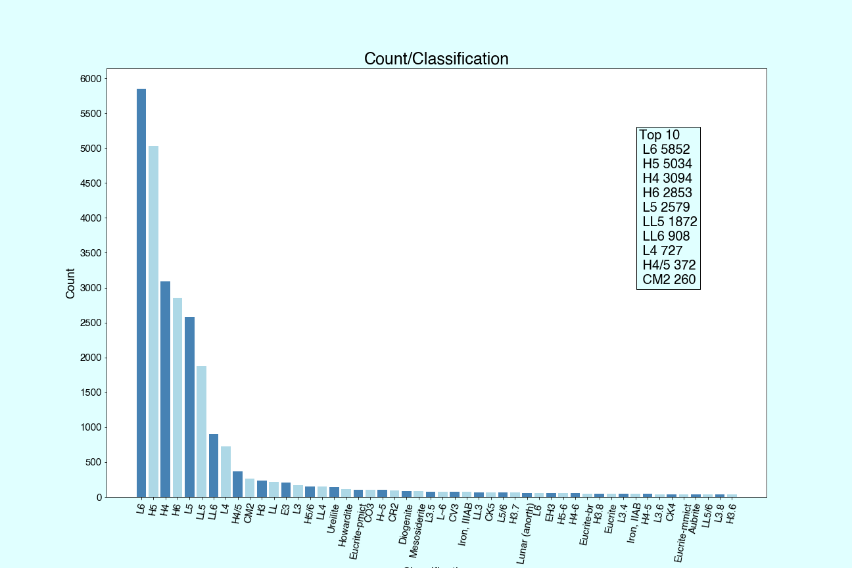

Slide 8

Hypothesis
Most reported meteors from the dataset seem to be in Antarctica. This got me thinking.
H0 : Given a meteorite is headed towards Antarctica, it is just as likely the meteor will be a type 'H4' as it would an 'H6’
H1: Given a meteorite is headed towards Antarctica, the likelihood of it being a type 'H4' is not the same as being an 'H6’
alpha = .05 Total Samps = 25138: recclass: H4 3094
H6 2853
Counts
Africa 2351
Antarctica 21325
Australia 383
Blacksite 1648
China 41
Europe 72
India 18
Japan 12
Middle East 1579
New Zealand 1
SouthAmerica 405
USA 684
Ho: P1 = P2 p = (p1 n1 + p2 n2) / (n1 + n2) pooled sample proportion
Ha: P1 ≠ P2 SE = sqrt{ p ( 1 - p ) (1/n1) + (1/n2) } standard error
z = (p1 - p2) / SE test statistic '’’
pH4 = 3094/25138
pH6 = 2853/25138 n =25138
P = ((3094/25138) 25138 + (2853/25138) 25138)/(25138 + 25138)
SE = np.sqrt(p (1-p) ((1/n) + (1/n)))
z = (pH4 - pH6) / SE # 2.475629302178118
After running a normal distribution on z
pscore = 0.013301
This is a two-tailed test, pscore for each side is 0.00665
I will reject the null hypothesis and accept the alternative!

Slide 9
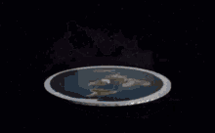
The End
https://github.com/SmashAF

